Slide 1



Mushrooms Classification
group 5：
s2136386 Naxin Dong
s2164009 Jiaxin Wang
s2165529 Xiaowei Zhang
s2166997 Xinrui Guo
s2129915 Pushpanjali Nagarajan

Slide 2
CONTENTS
01
Background and Objectives
02
Dataset Description
03
Data Exploration
04
Data Pre-processing
05
Modeling
06
Model Comparison
07
Task Division

Slide 3
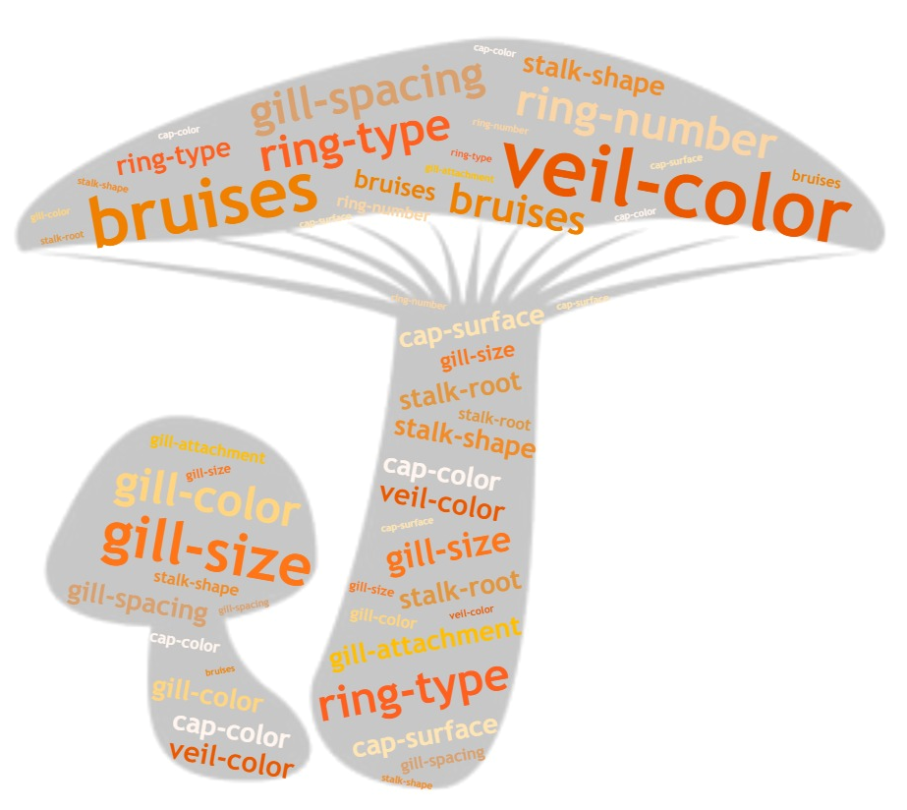

01
Background and Objectives
Mushrooms are widely eaten plants, but some mushrooms may be poisonous, and ingestion can lead to poisoning and even life-threatening. Mushroom poisoning is common in Malaysia, with a total of 71 cases of mushroom poisoning in Malaysia. Therefore, it is important to classify whether mushrooms are poisonous or not; and to study which properties of mushrooms are related to their toxicity.
Traditional mushroom classification methods mainly rely on experience and professional knowledge, which cannot be 100% accurate and safe. Therefore, this project aims to use machine learning technology to classify mushrooms and try to establish a reliable model for classification prediction for picking security.

Slide 4
02
Dataset Description
We use the data set from the Mushroom Records drawn from The Audubon Society Field Guide to North American Mushrooms (1981). G. H. Lincoff (Pres.), New York: Alfred A. Knopf. Afterwards, Jeff Schliemer, Ph.D., Department of Information and Computer Science, University of California, organized it and published it in his own paper on April 27, 1987.
The data set includes descriptions of hypothetical samples corresponding to 23 species of gilled mushrooms in the Agaricus and Lepiota Family, including 8124 instances and 22 attribute values. The attributes include classification variables of mushrooms, such as cap, odor, gill, stack, vessel, and habitat.
There are two classes of target variables, edible (denoted by e) and poisonous (denoted by p). The distribution of the dataset is roughly balanced, including 4208 (51.8%) edible mushroom instances and 3916 (48.2%) poisonous mushroom instances. In addition, there are 2480 missing values in the attribute of mushroom stalk-root, which needs to be processed in the future.

Slide 5
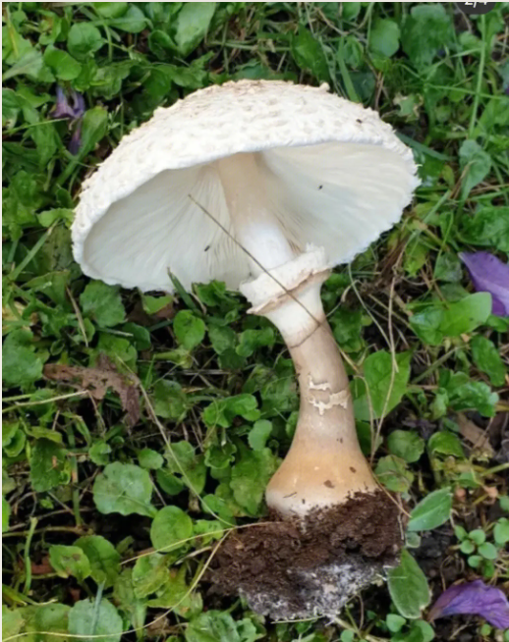
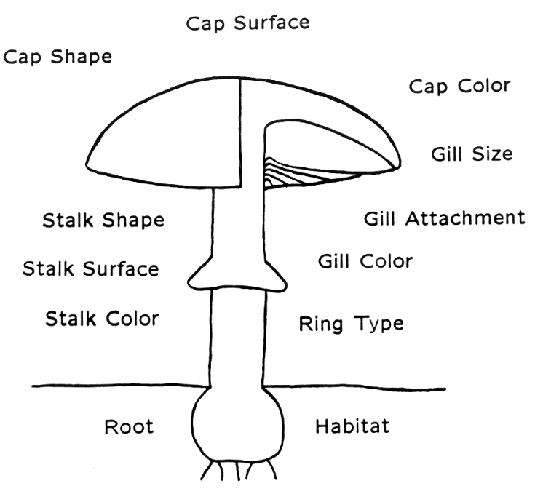
Attributes Information:
1. cap-shape: bell=b,conical=c,convex=x,flat=f, knobbed=k,sunken=s
2. cap-surface: fibrous=f,grooves=g,scaly=y,smooth=s
3. cap-color: brown=n,buff=b,cinnamon=c,gray=g,green=r,pink=p,purple=u,red=e,white=w,yellow=y
4. bruises: bruises=t,no=f
5. odor: almond=a,anise=l,creosote=c,fishy=y,foul=f,musty=m,none=n,pungent=p,spicy=s
6. gill-attachment: attached=a,descending=d,free=f,notched=n
7. gill-spacing: close=c,crowded=w,distant=d
8. gill-size: broad=b,narrow=n
9. gill-color: black=k,brown=n,buff=b,chocolate=h,gray=g,green=r,orange=o,pink=p,purple=u,red=e,white=w,yellow=y
10. stalk-shape: enlarging=e,tapering=t
11. stalk-root: bulbous=b,club=c,cup=u,equal=e,rhizomorphs=z,rooted=r,missing=?
12. stalk-surface-above-ring: fibrous=f,scaly=y,silky=k,smooth=s
13. stalk-surface-below-ring: fibrous=f,scaly=y,silky=k,smooth=s
14. stalk-color-above-ring: brown=n,buff=b,cinnamon=c,gray=g,orange=o,pink=p,red=e,white=w,yellow=y
15. stalk-color-below-ring: brown=n,buff=b,cinnamon=c,gray=g,orange=o,pink=p,red=e,white=w,yellow=y
16. veil-type: partial=p,universal=u
17. veil-color: brown=n,orange=o,white=w,yellow=y
18. ring-number: none=n,one=o,two=t
19. ring-type: cobwebby=c,evanescent=e,flaring=f,large=l,none=n,pendant=p,sheathing=s,zone=z
20. spore-print-color: black=k,brown=n,buff=b,chocolate=h,green=r,orange=o,purple=u,white=w,yellow=y
21. population: abundant=a,clustered=c,numerous=n,scattered=s,several=v,solitary=y
22. habitat: grasses=g,leaves=l,meadows=m,paths=p,urban=u,waste=w,woods=d

Slide 6
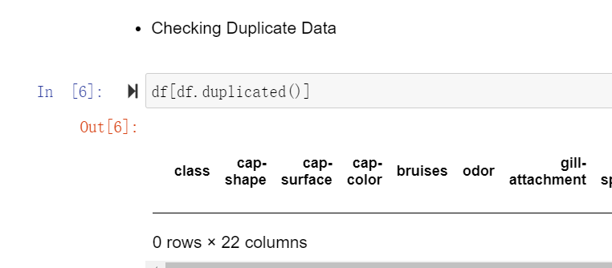
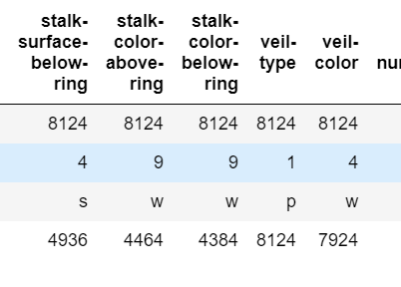
03
Data Exploration
No duplicate data.
The veil-type column has a unique value and can be deleted as a redundant column.

Slide 7
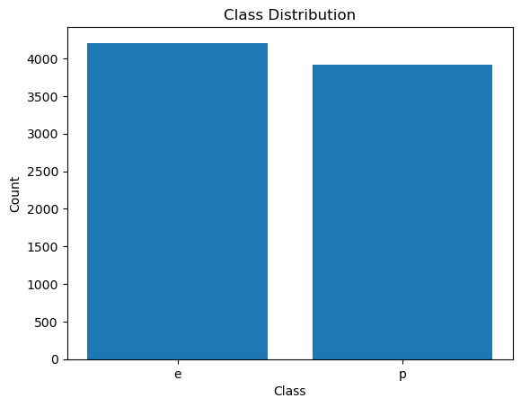
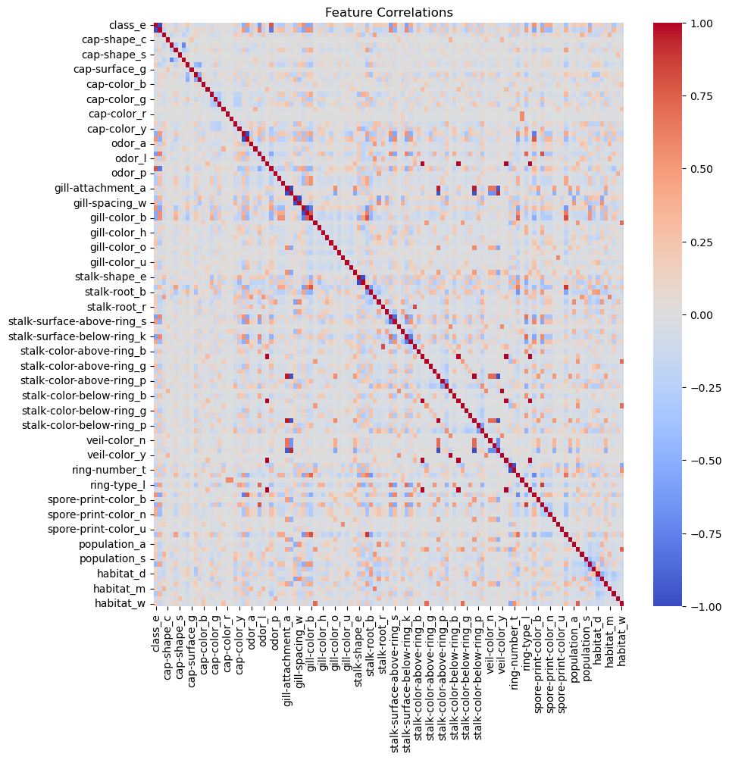
03
Data Exploration

Slide 8
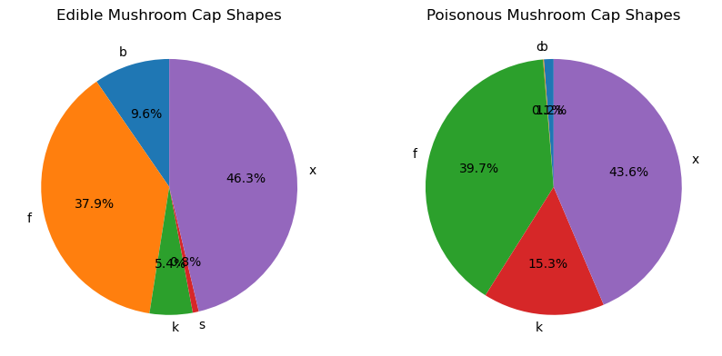
03
Data Exploration
1. The bar chart shows the distribution of target variables (classes) in the data set, showing that the data is balanced.
2. The heat map shows that there are some attributes that have a certain correlation with the category of mushrooms, such as odor.
3. It can be seen that there is no poisonous mushroom with a cap shape of sunken.

Slide 9
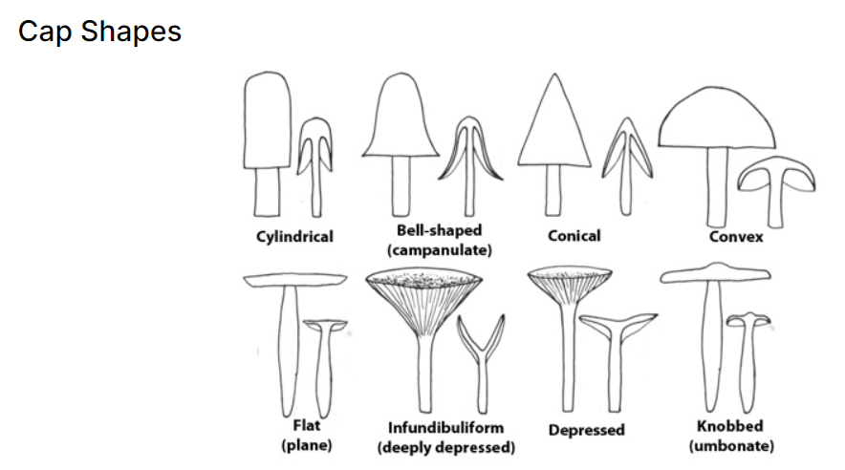
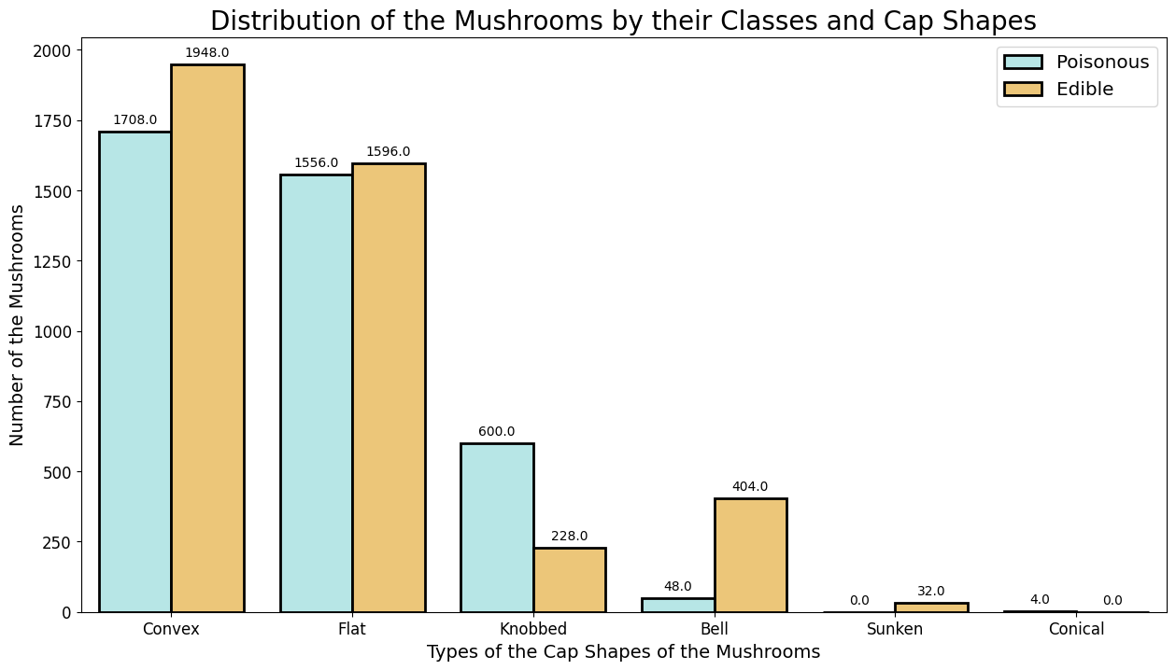
03
Data Exploration
Convex and flat cap shapes mushrooms are the most numerous, knobbed cap shapes mushrooms are mostly poisonous, and bell-shaped mushrooms are mostly edible.

Slide 10
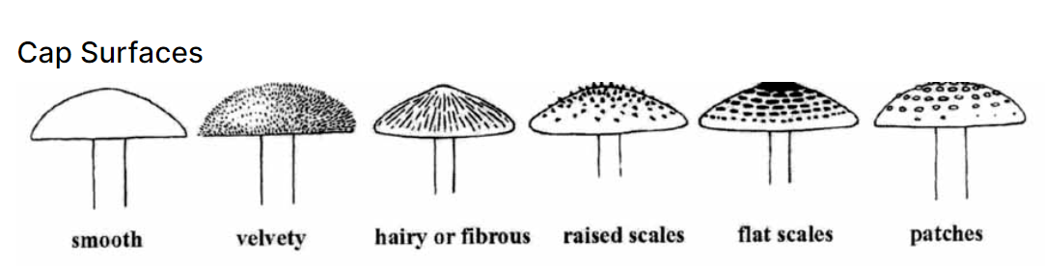
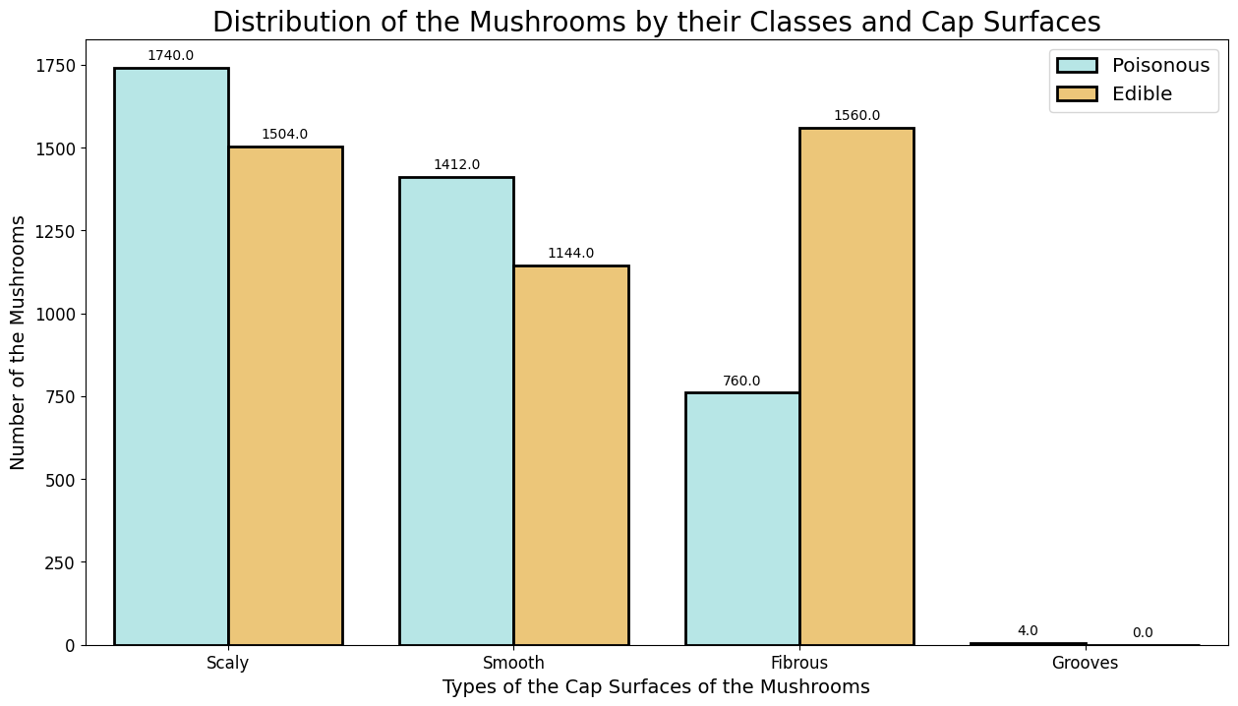
03
Data Exploration
The fibrous cap surface mushroom is more edible.

Slide 11
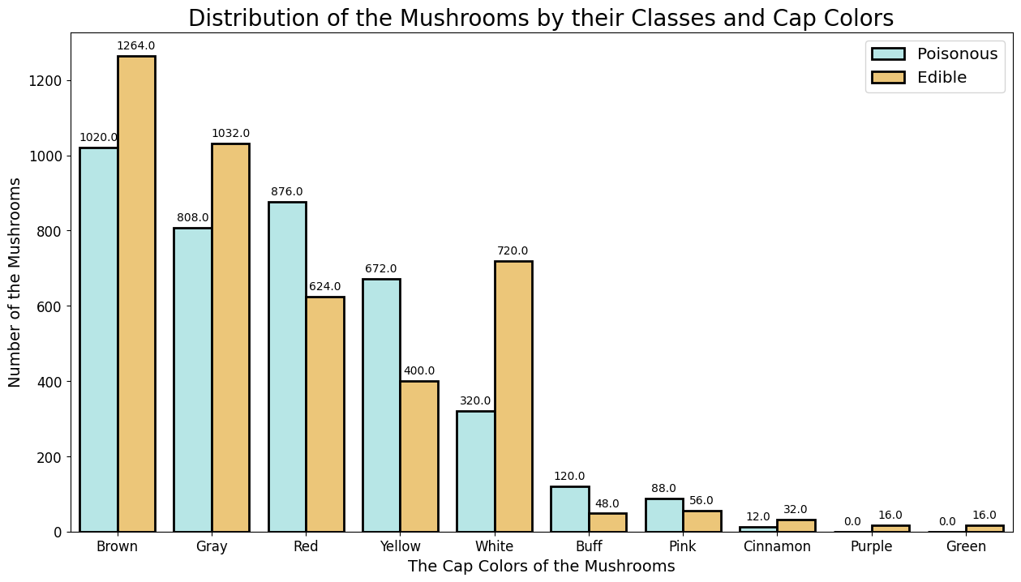
03
Data Exploration
The cap surface is brown and gray mushrooms are the most, and the cap surface is yellow and red mushrooms are more poisonous.

Slide 12
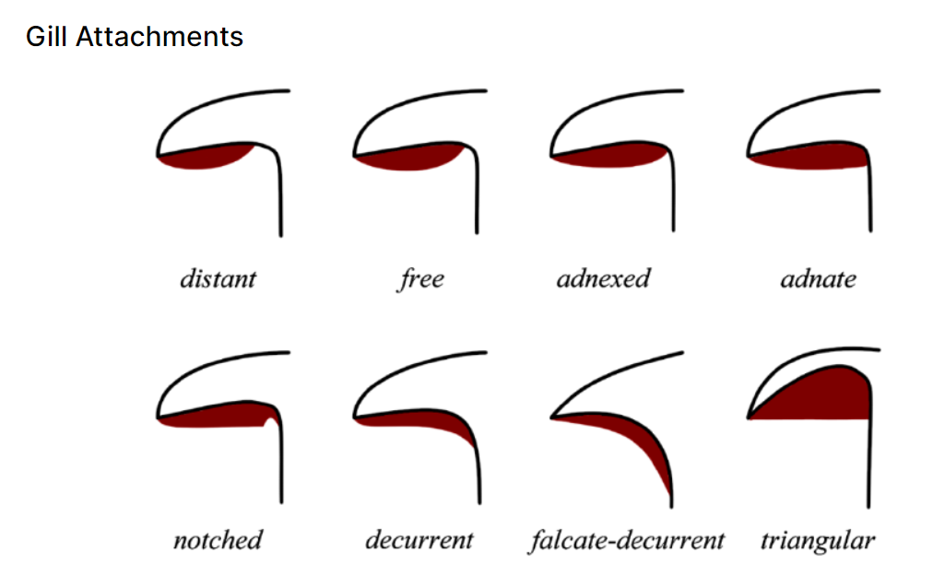
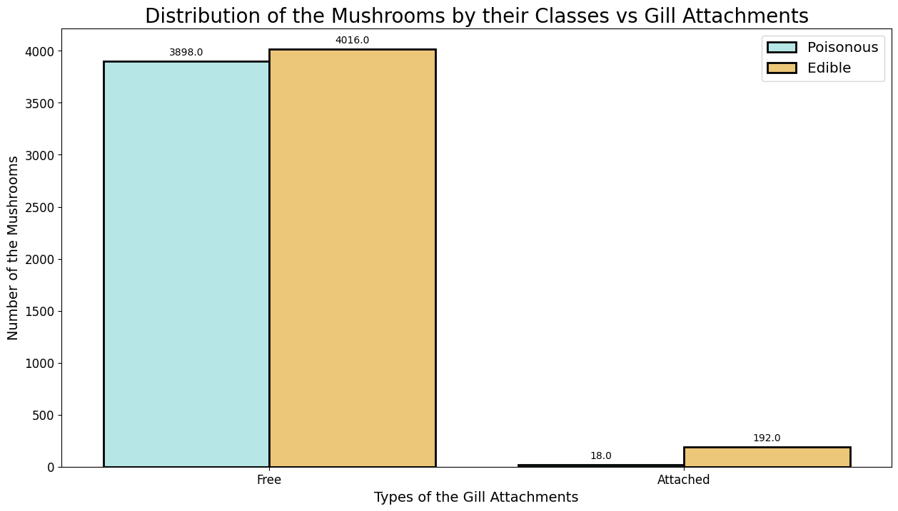
03
Data Exploration
Most of the sample mushrooms have free gill attachment.

Slide 13
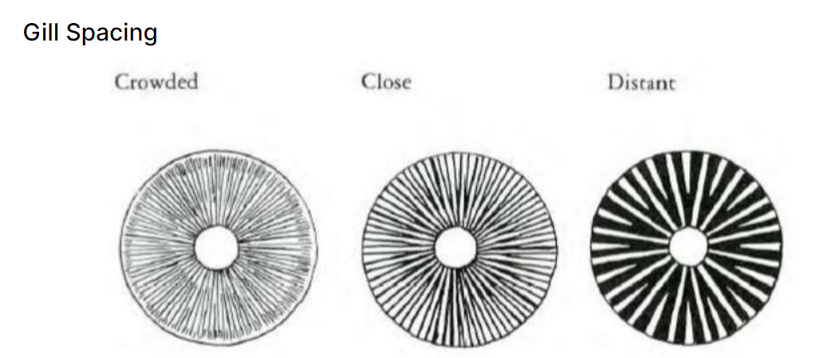
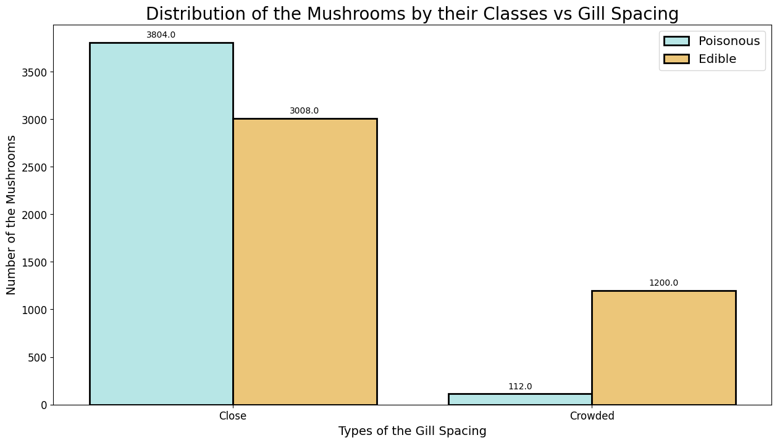
03
Data Exploration
Crowed gill spacing mushrooms are mostly edible.

Slide 14
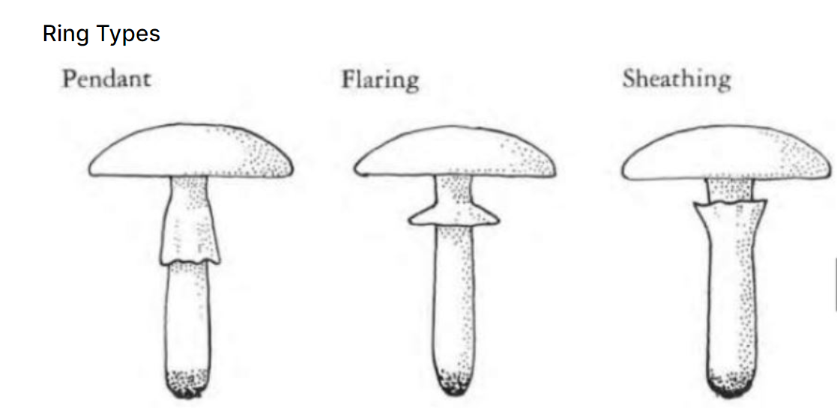
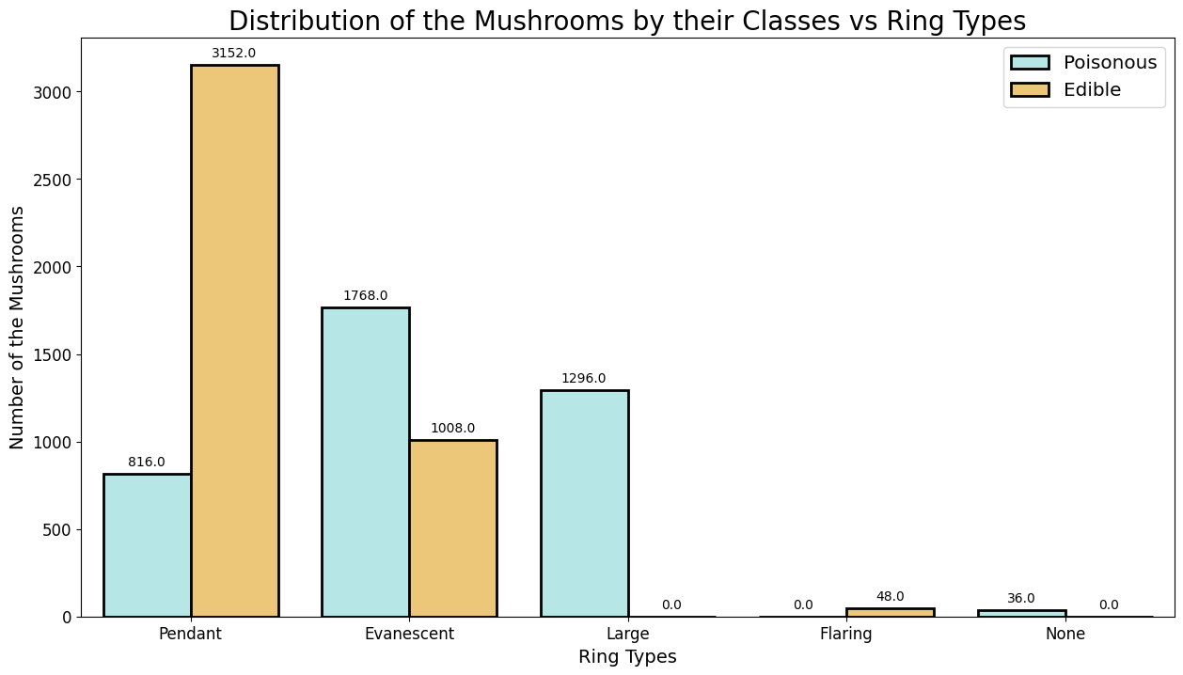
03
Data Exploration
The ring type is the pendant type of mushrooms, most of which are edible; evanescent and large ring type mushrooms may be poisonous, especially large ring type mushrooms

Slide 15
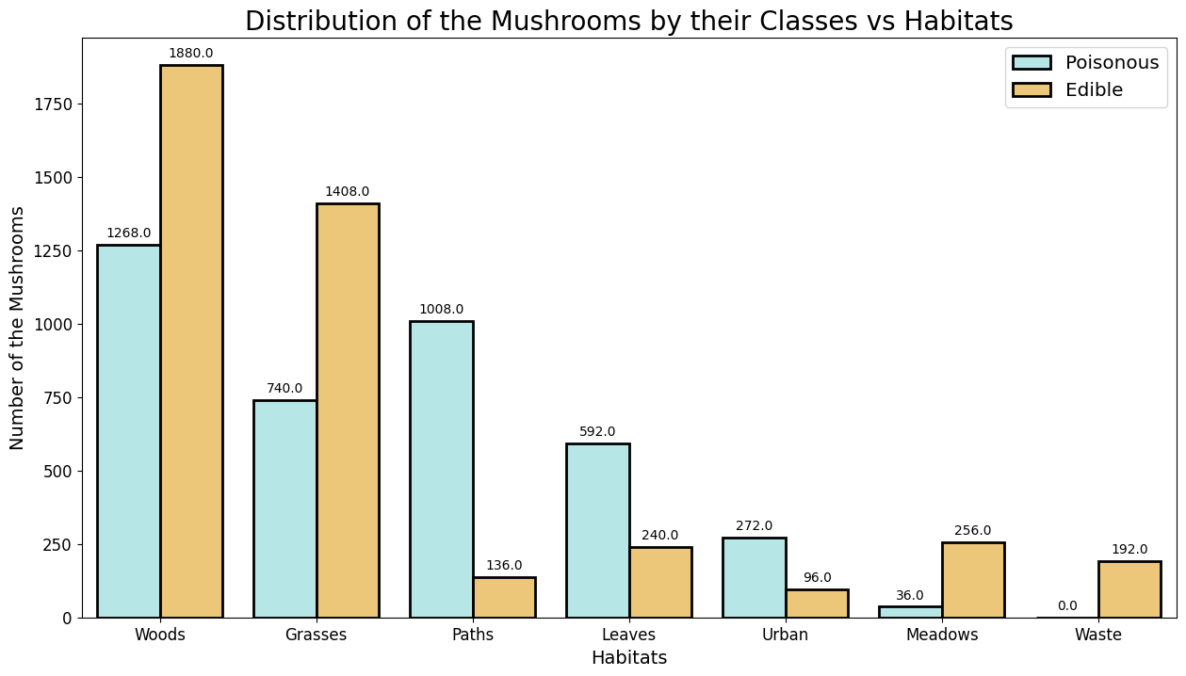
03
Data Exploration
The mushrooms living in woods and grasses are the most, most of them are edible; most of the mushrooms living in paths and leaves habitats are poisonous.

Slide 16
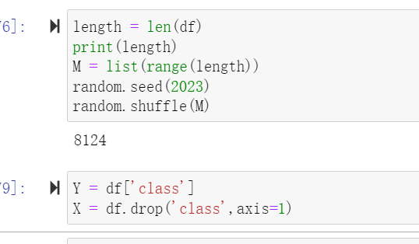
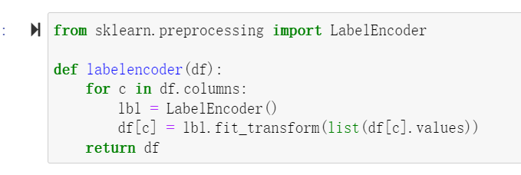
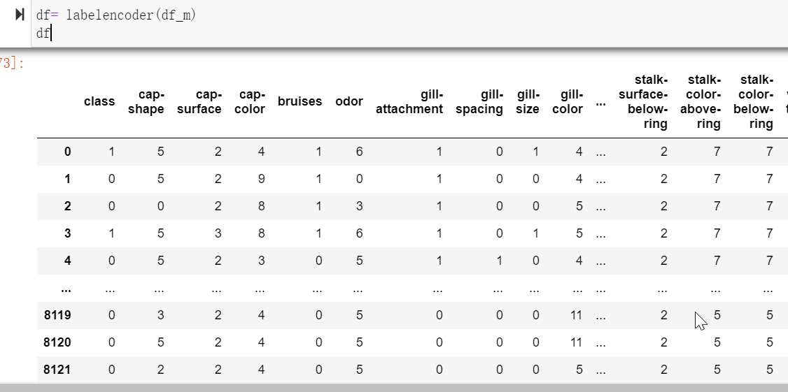
04
Data Pre-processing
Digitize the category data.
The data set used for training the model usually needs to be shuffled in advance.
Set 'class' as the target column.

Slide 17
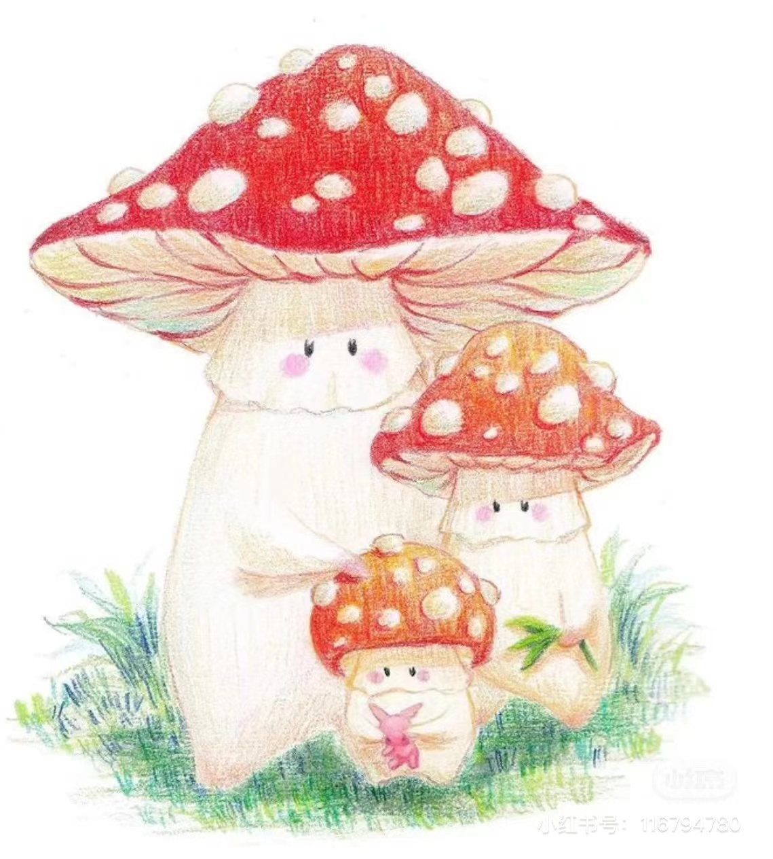
05
Modeling
Decision Trees
Random Forest
Logistic Regression
k-Nearest Neighbors
Naive Bayes

Slide 18
06
Model Comparison
In order to comprehensively evaluate and compare the performance of different classification models, we will use the following evaluation methods:
Precision: Precision measures the proportion of true poisonous mushrooms in samples predicted as poisonous mushrooms, which can accurately reflect the accuracy of different classifiers in predicting poisonous mushrooms.
Recall: Recall measures the proportion of all real poisonous mushrooms predicted by the classifier as poisonous mushrooms. The higher the recall rate, the stronger the classifier's ability to identify real cases.
F1 score: F1 score is the harmonic average of precision and recall, which can comprehensively evaluate the performance of the classifier by considering both precision and recall.
Confusion matrix: it shows the relationship between the predicted result and the real result of the classifier. The row represents the actual result, and the column shows the predicted result. It helps us understand the performance of the model more intuitively, so as to further optimize the model.

Slide 19
07
Task Division
Naxin Dong： Model practical implementation and comparisons (Practical)
Conclusion and future work
Machine learning model diagram and explanation
Pushpanjali Nagarajan： Machine learning model diagram and explanation
Presentation
Jiaxin Wang： Mobile application prototype design (5 Screens)
Machine learning model diagram and explanation
Xiaowei Zhang：Dataset description and pre-processing (Practical)
Machine learning model diagram and explanation
Xinrui Guo：Introduction—(Problem and Objective)
Machine learning model diagram and explanation
Create slides and tidy up report formats

Slide 20
THANK YOU
FOR WATCHING

